Slide 1












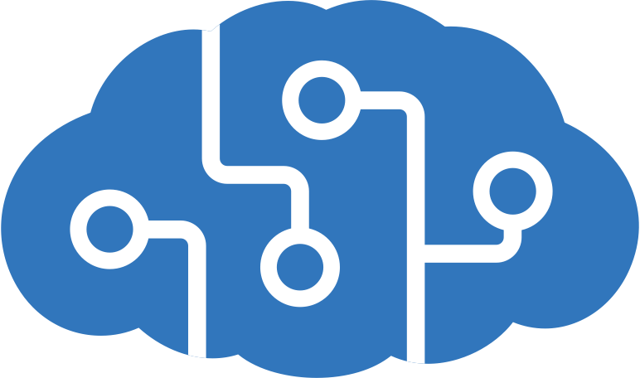
Clients
Azure Load Balancer
Azure Kubernetes Service (AKS)
CI/CD
Front end
Microservices
Azure
Cosmos DB
Admin site
Registration
Content
GitHub
Actions
helm upgrade
Conference
Web site
Email
Config
Azure Database
for PostgreSQL
docker push
Container
Registry
docker pull
Linux Nodes
Virtual Network
RBAC
DevOps
Azure AD
Azure Cognitive Services
Notes:
Reference Links:
https://docs.microsoft.com/en-us/azure/architecture/reference-architectures/microservices/aks

